Slide 1
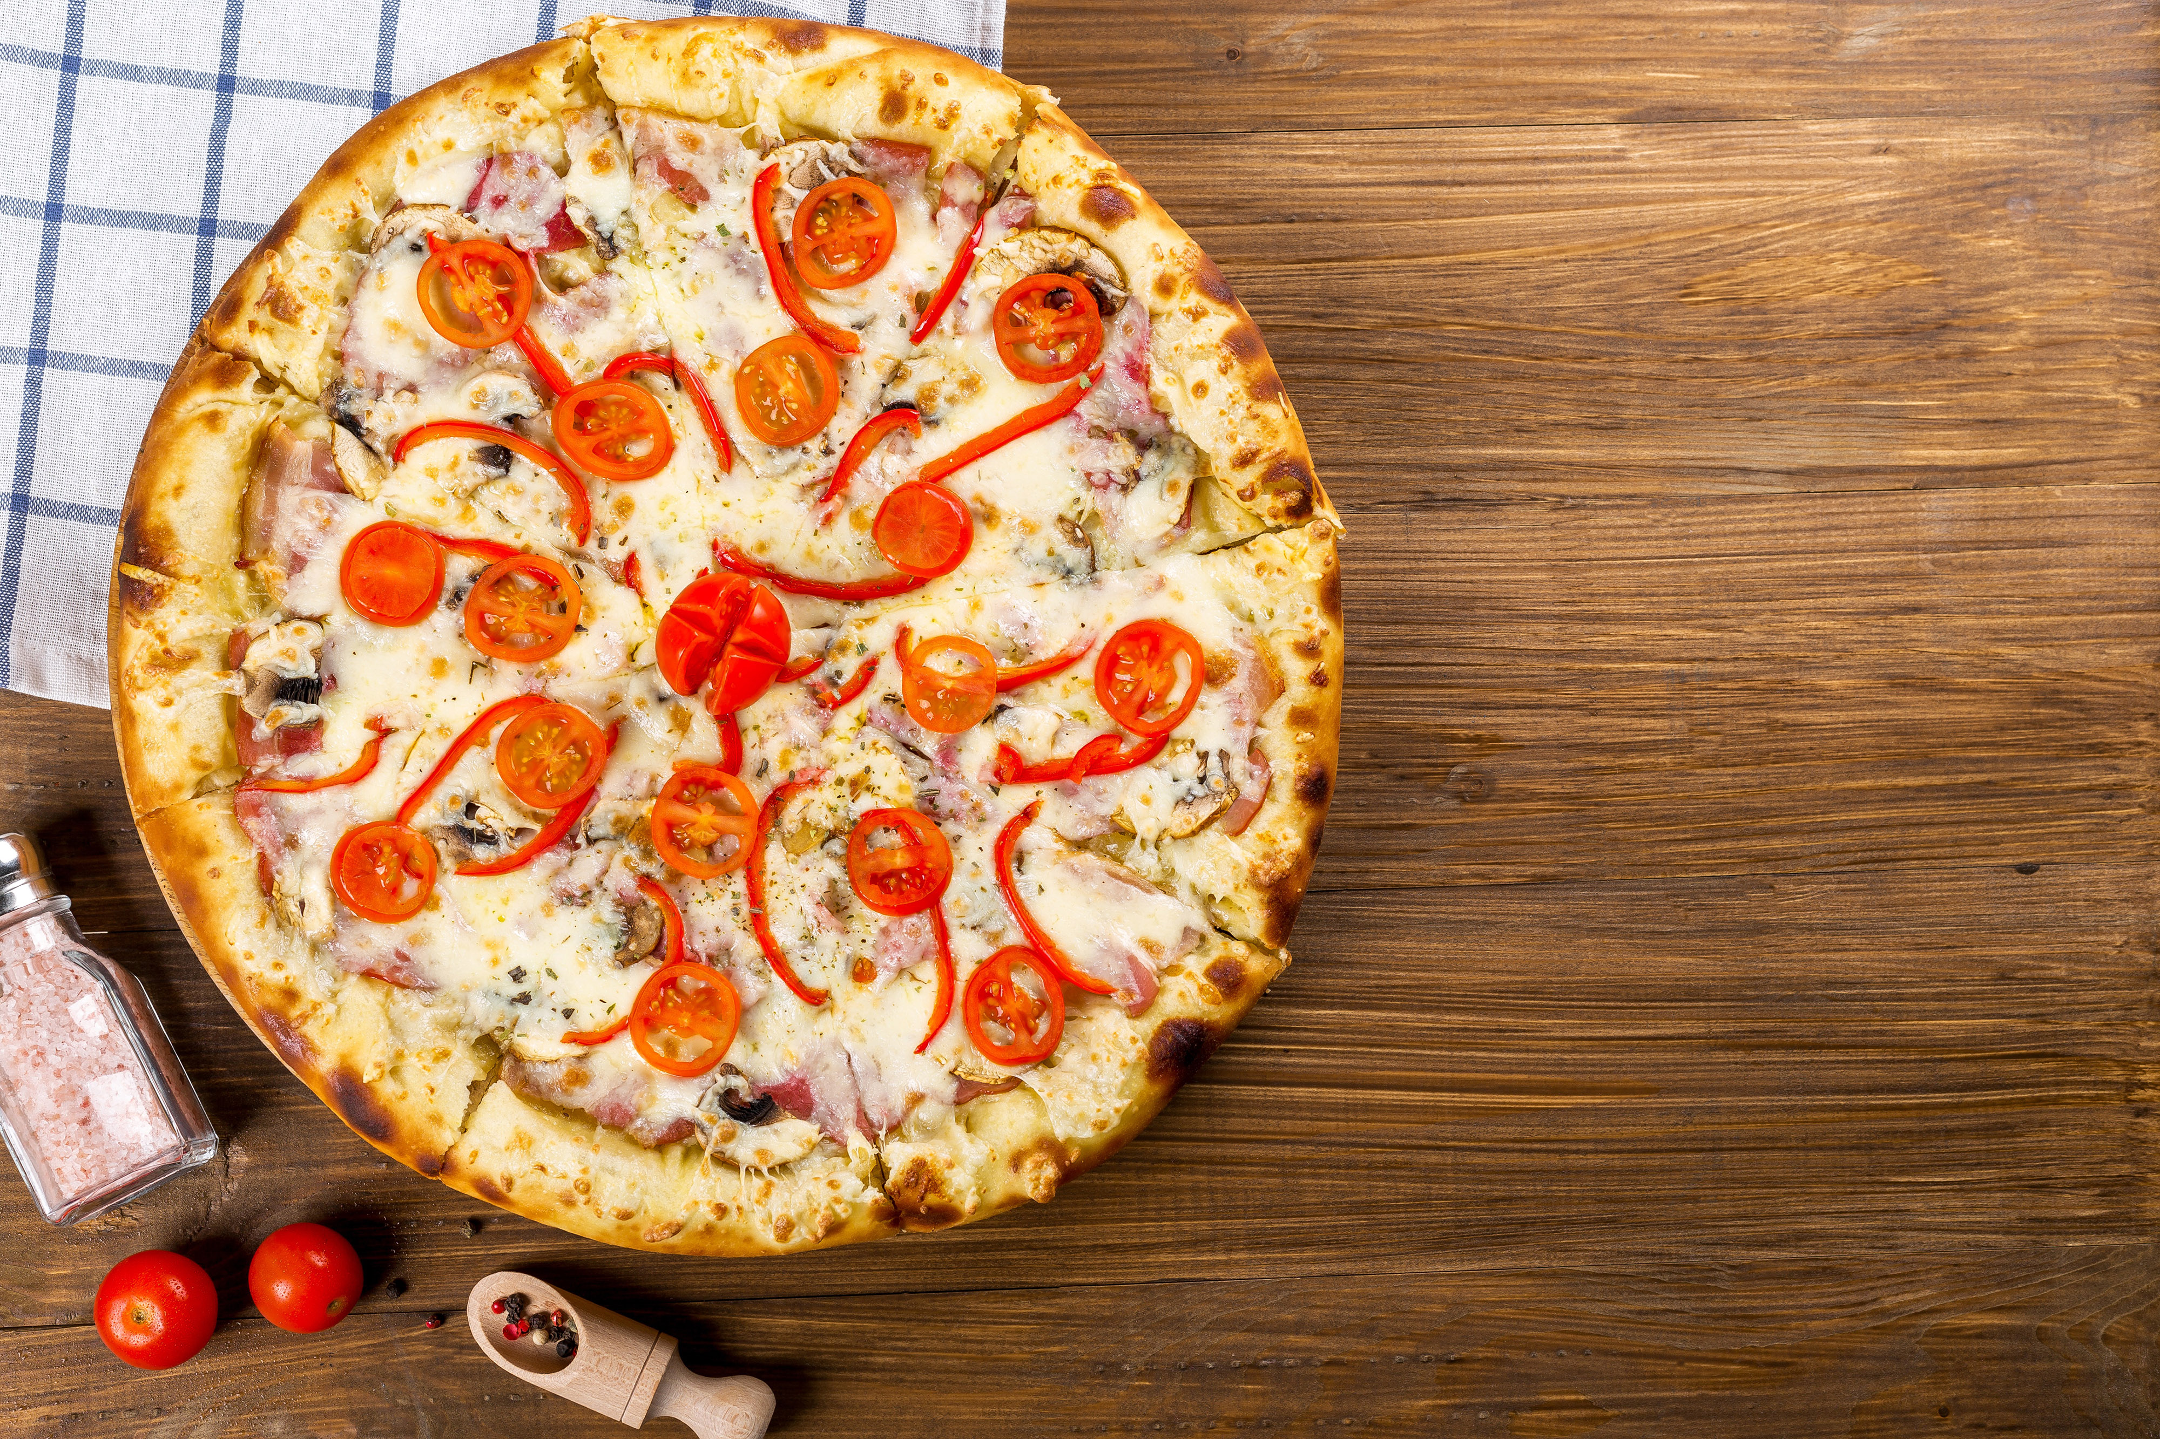
Pizza Sales
Analysis
Project Owner – Honey Jain

Slide 2
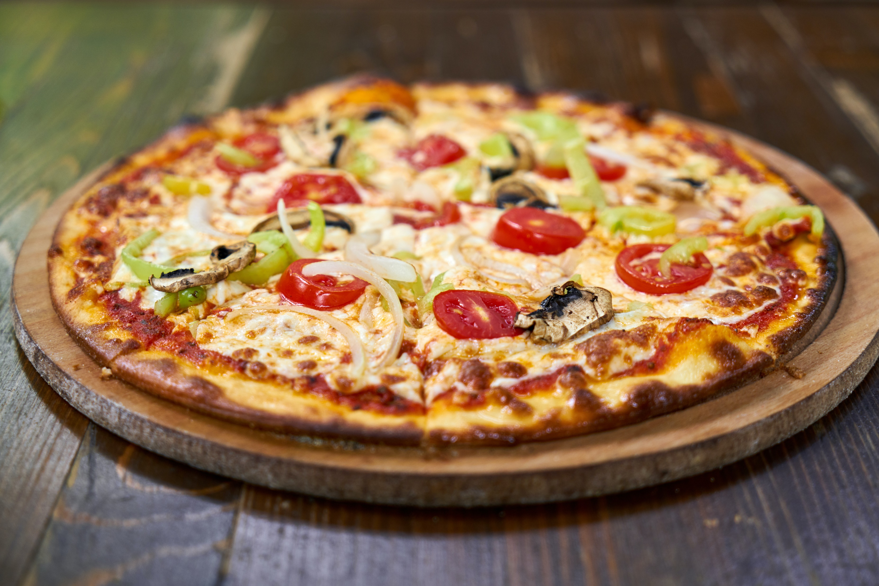
Problem Statement
Find out how many customers do we have each day? Are there any peak hours?
How many pizzas are typically in an order? Do we have any bestsellers?
Can we Identify daily trends in the sales?
Identify the total percentage of the sales by category.
How much money did we make this year? Can we identify any seasonality in the sales?
Are there any pizzas we should take off the menu, or any promotions we could leverage?

Slide 3
Find out how many customers do we have each day? Are there any peak hours?
Q1
Average Customers Per Day
On an average we have 136 customers per day
Hourly Trend For Total Orders
There are maximum Orders From 12PM-1PM And 5PM-6PM

Slide 4
How many pizzas are typically in an order? Do we have any bestsellers?
Q2
We have 3 pizza are typically in an order.
Top 5 Best Sellers By Total Pizza Sold
1451
1324
five_cheese_l
four_cheese_l
big_meat_s
thai_ckn_l
classic_dlx_m
1777
1357
1096
Best
big_meat_s Pizza are the best sellers
Worst
the_greek_xxl is at the bottom

Slide 5




We made this year $ 801,994.70 amount of money
How much money did we make this year? Can we identify any seasonality in the sales?
Q3
We made this year $802,289.25 amount of money.
24.49%
Winter
Spring
25.69%
25.55%
Summer
Fall
24.27%

Slide 6
How much money did we make this year? Can we identify any seasonality in the sales?
Q4
We can take off the pizza from the menu is : the_greek_xxl reason is simple it is lowest ordered pizza in that year and Since the Spring season already saw the largest pizza sales and the Fall season saw the lowest pizza sales, so we can provide a seasonal discount or special offers according to season.
Top 5 Worst Sellers By Total Pizza Sold
74
110
ckn_alfredo_s
calabrese_s
the_greek_xxl
green_garden_l
mexicana_s
38
101
155

Slide 7
Can we Identify daily trends in the sales?
Q5
Orders are highest on Thursday/Friday.
3158
Sat
3538
Fri
3239
Thurs
3024
Wed
2973
2794
Tue
2624
Mon
Sun

Slide 8
Identify the total percentage of the sales by category.
Q6
Classic Category Contribute to maximum sales & orders
14543
11710
Classic
Supreme
Veggie
Chicken
11755
10612
Large Size Pizza Contribute to Maximum Sales

Slide 9
Thank Y u

